Slide 1
DEPLOYING WORDPRESS WEB APPLICATION USING DOCKER IN AMAZON WEB SERVICES
BY
AKHIL.B

Slide 2
Objectives
Amazon web services
Git
WordPress web application
Docker and Docker-compose
Route 53
How to deploy WordPress web application in the server using docker

Slide 3
What is AWS
The Amazon Web Services (AWS) platform provides more than 200 fully featured services from data centers located all over the world and is the world's most comprehensive cloud platform.
Amazon web service is an online platform that provides scalable and cost-effective cloud computing solutions.
AWS is a broadly adopted cloud platform that offers several on-demand operations like compute power, database storage, content delivery, etc., to help corporates scale and grow.

Slide 4
What is Git
Git is a free and open-source distributed code management and Version control system that is distributed under the GNU General Public License version.
In addition to software version control, Git is used for other applications including configuration management and content management.

Slide 5
What is WordPress
WordPress is a free, open-source website creation platform. On a more technical level, WordPress is a content management system (CMS) written in PHP that uses a MySQL database. In non-geek speak, WordPress is the easiest and most powerful blogging and website builder in existence today.

Slide 6
Features of WordPress
The most important features of WordPress are that you can create a dynamic website without any programming and design knowledge.
WordPress is theme-based, providing you with options for various open-source and premium design themes that can be integrated easily without any designing knowledge.
Plugins extend the functionality of WordPress, which can be used to add new required modules.

Slide 7
Docker
Docker is an open platform for developing, shipping, and running applications. Docker enables you to separate your applications from your infrastructure so you can deliver software quickly. With Docker, you can manage your infrastructure in the same ways you manage your applications.
By taking advantage of Docker’s methodologies for shipping, testing, and deploying code quickly, you can significantly reduce the delay between writing code and running it in production.

Slide 8
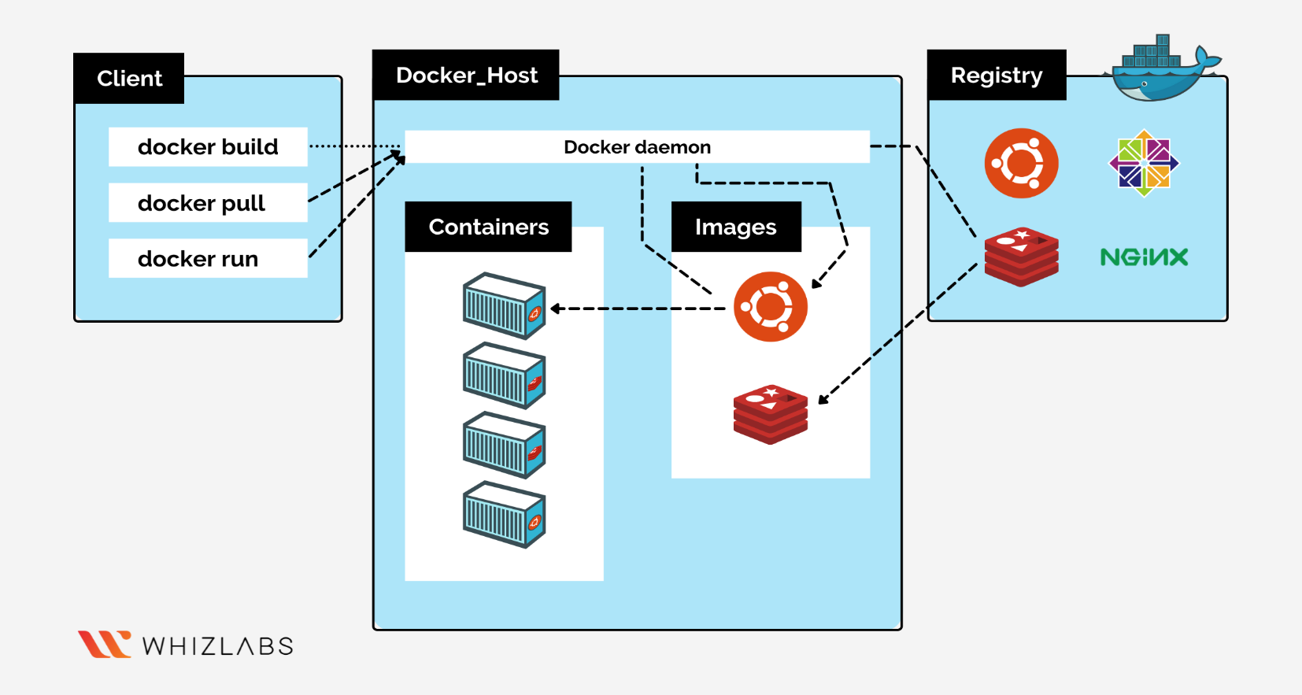
Docker Architecture

Slide 9
Docker-compose
Docker-compose is a tool that was developed to help define and share multi-container applications. With Compose, we can create a YAML file to define the services and with a single command, we create and start all the services from your configuration.

Slide 10
Route 53
Amazon Route 53 is a highly available and scalable Domain Name System (DNS) web service.
Route 53 connects user requests to internet applications running on AWS or on-premises.
AWS Route 53 Provides three Services they are:
Domain names
Setup your DNS Routing
Customize your DNS routing policies to reduce latency

Slide 11
How to deploy WordPress web application using docker
Launch the Amazon Linux machine with the help of Amazon web services.
While Launching, in security groups provide SSH, HTTP, and HTTPS port numbers.
SSH - 22
HTTP – 80
HTTPS – 443
After Creation connect this Linux machine with the console Git Bash/terminal.

Slide 12
Installing Git, Docker, and related repos
Install git in the Local machine using
Sudo yum –y install git
Install Docker in our instance and Give permission to add a limited Linux user account to the docker.
sudo yum –y install docker
sudo usermod -a -G docker ec2-user
sudo systemctl start docker
Sudo systemctl enable docker

Slide 13
Installing Git, Docker and related repos
Now install the latest version of docker-compose using the below command
sudo curl -L https://github.com/docker/compose/releases/download/1.22.0/docker-compose-$(uname -s)-$(uname -m) -o /usr/local/bin/docker-compose
Apply executable permissions to the binary and create symbolic link
sudo chmod +x /usr/local/bin/docker-compose
sudo ln -s /usr/local/bin/docker-compose /usr/bin/docker-compose

Slide 14
Creating WordPress setup for Docker images with help of YAML scripting
we have to create docker-compose. yaml file to pull images from the docker hub
Sudo vi Docker-compose. yaml
We have to run this locally with docker-compose
sudo docker-compose up -d
By using docker-compose.YAML files it was pulling images are MySQL and WordPress.

Slide 15
Setup Route53 DNS Routing
Create Hosted zone in Route53
Create Records(Subdomains)
Copy the name Servers, Go to your domain-provided platform and replace the name servers with these name servers.
In this domain-provided platform creates a record which is points to our instance IP address
After Done with every step search with your domain name In the browser
Note: It will take some time to configure.

Slide 16
THANK YOU…

